Slide 1

R Markdown: Efficient Reporting Workflows
Rich Hanna, MS
(that one guy who’s constantly posting on Slack)
hannar1@email.chop.edu
CHOP Critical Care Medicine

Slide 2






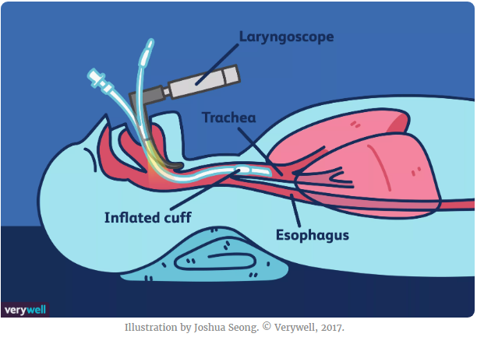
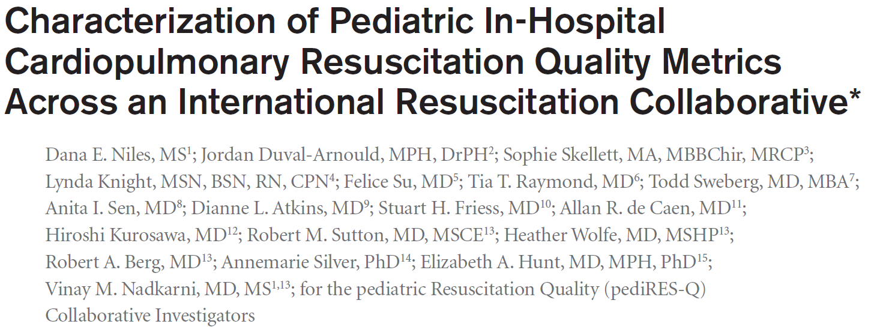
Background

Slide 3





Background

Slide 4


Background

Slide 5

Background

Slide 6


What is R?
What else do I need?
Statistical Programming Language
Made by statisticians for statisticians
But also capable of much more!
Open source (free) with a focus on data science
Packages:
ggplot2()
dplyr()
RStudio
Privately owned company
Integrated Development Environment of choice for R
Free (for the most part)

Slide 7




Anything Else?
An incessant loathing of Excel
A desire to learn

Slide 8

Project Materials
CHOP R User Group.Rproj
.Rproj file
.Rhistory for command history
.Rdata for object and workspace storage
CHOP R User Group.rmd
reference.docx
heart.csv

Slide 9
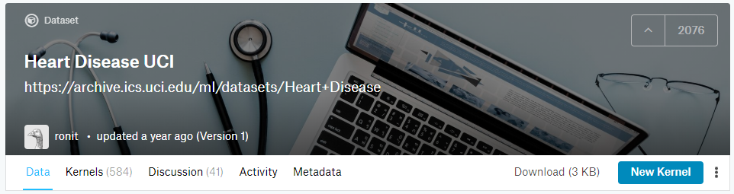
Kaggle
Online community platform for data scientists owned by Google
Offers public data sets for competitions and exploration
We will be exploring the `heart.csv`
14 attributes from UCI Machine Learning Repository
303 patients

Slide 10

RProjects
R Projects come with many benefits:
Remove need to declare working directories
Relocate without worry
Capitalize on file explorer view pane
Load last saved displays and environments

Slide 11
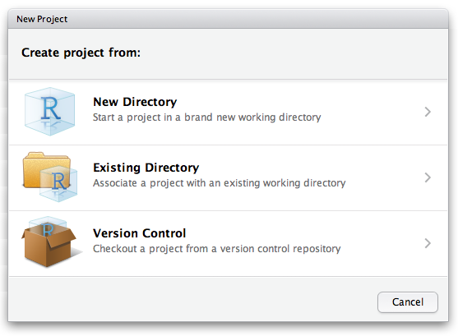
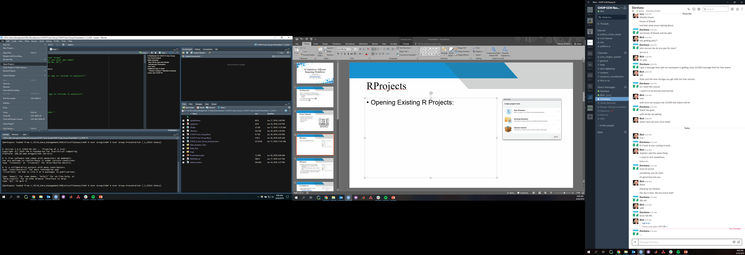
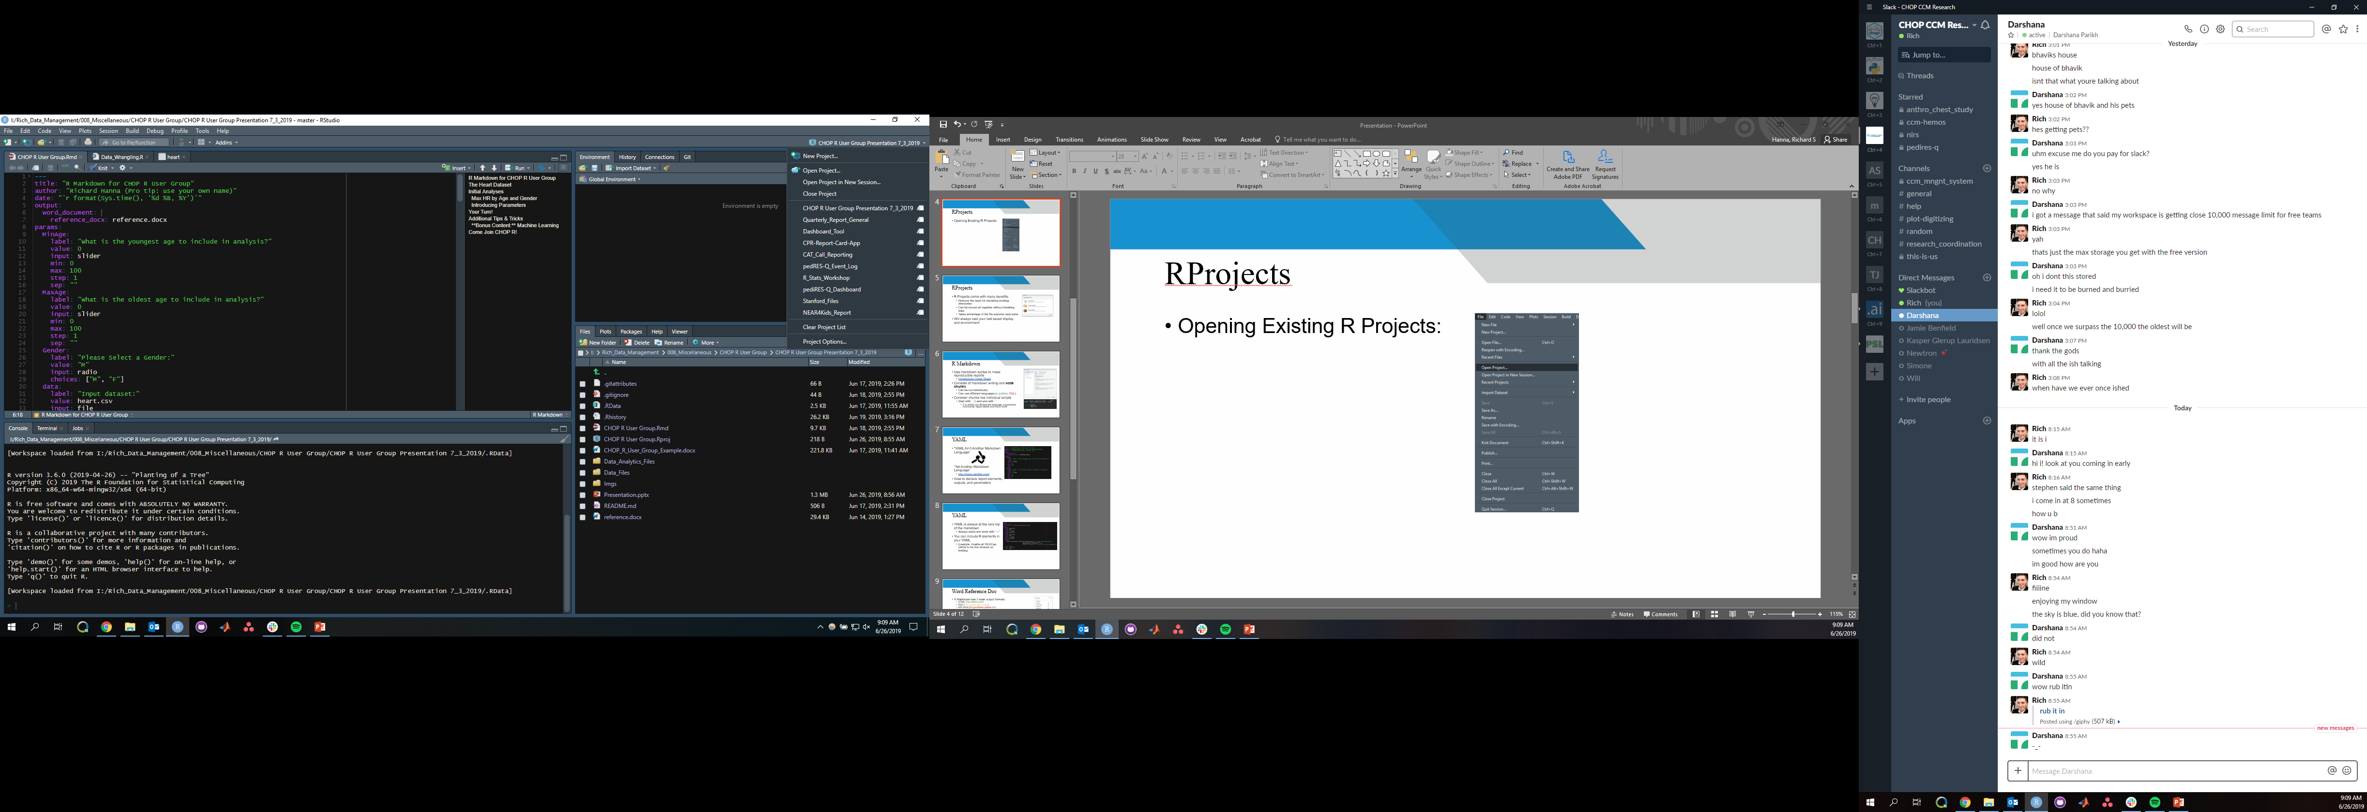
RProjects
Creating New R Projects:
Opening Existing R Projects:

Slide 12

R Markdown
What is “a markdown?”
A plain text formatted file
Focus on readability and format conversion
So what is R Markdown?
Interactive r-based markdown file
Ready-made with Rstudio
Also it’s own package
Create interactive, reproducible outputs

Slide 13
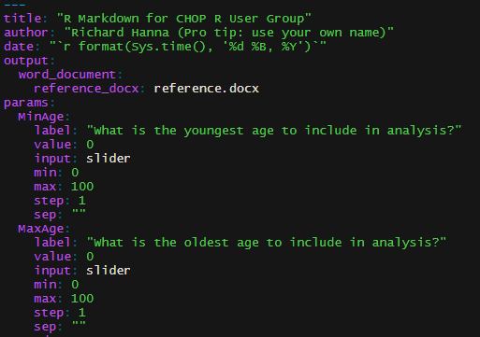

R Markdown - YAML
“YAML Ain’t Markup Language” “Yet Another Markup Language”
http://www.yamllint.com/
Data serialization language with a focus on human readability
Area to declare report elements, outputs, and parameters

Slide 14
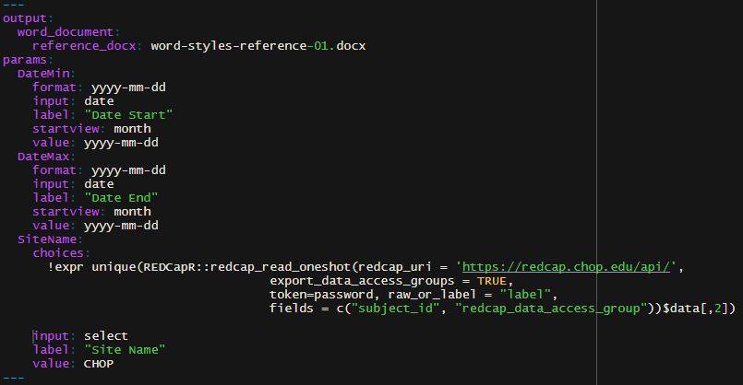
R Markdown - YAML
YAML is always at the very top of the markdown
Always starts and ends with “---”
You can include R elements in your YAML
Example: Enable all REDCap DAGs to be live choices on knitting

Slide 15
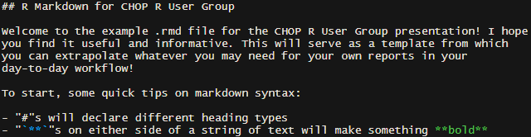
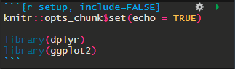
R Markdown Body
Free Standing Text
R Markdown Cheat Sheet
Control outputs, execute commands
`r 2+2`
**bold** = bold
_italic_ = italic
Code Chunks
Can be run individually
Can use different languages (r, python, SQL)
Start with ```{} and end with ```
Declare language
Control outputs
Specify outputs

Slide 16
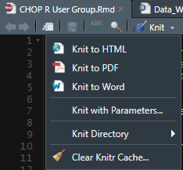

R Markdown Execution
With GUI
With Command Line
render_reports <- function(Site){
rmarkdown::render(
input = rmd_name,
output_format = flex_dashboard(theme = 'cerulean',
orientation = 'columns',
vertical_layout = 'fill'),
output_file = html_name,
output_dir = html_dir,
params = parameters
)
invisible(TRUE)
}
purrr::pmap(list(pediresq.DAGs_unique), render_reports)

Slide 17

R Markdown
The stuff you code
Package to dynamically execute R code
Document with code and output
The swiss army knife converter
The stuff you’re really proud of
Image supplied by Rstudio. Learn More Here

Slide 18
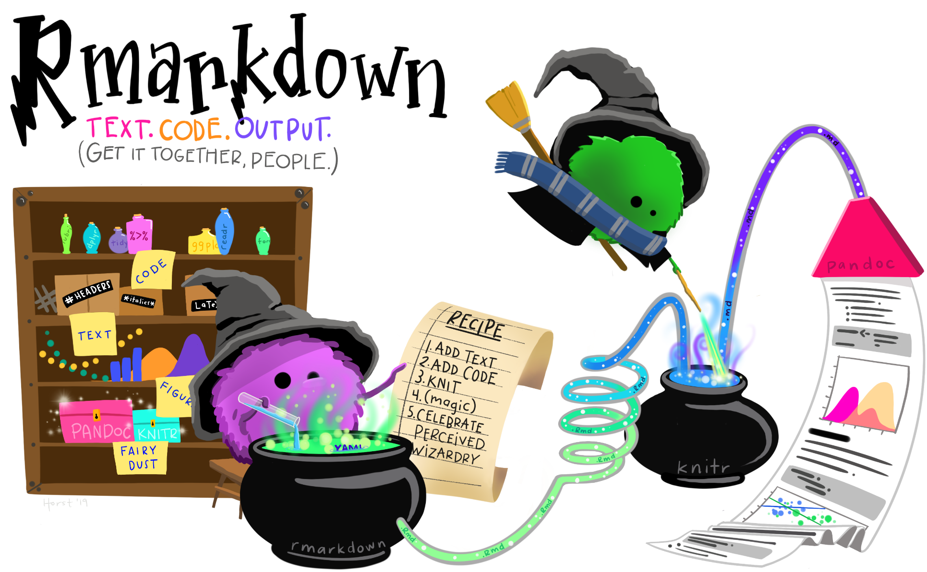
R Markdown
Credit to Allison Horst’s personifyr series Learn More Here

Slide 19
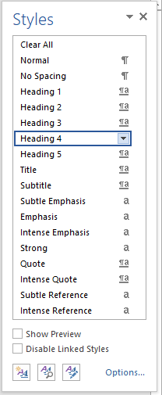

Word Reference Doc
R Markdown has 3 main output formats
HTML (Yay these rock!)
PDF (Ok I guess this is fine)
MS Word (oh goodness please no)
We will be working with Word…
The reference doc is what will control World Styles
Word Styles are declared in Word itself

Slide 20

Parameters
Similar to R functions:
function( user defined inputs ){ Body } → Controlled Output
filter(date >= params$MinDate) → Controlled Output
Inputs are user-defined on knit/render
Go to the bookdown chapter a lot!

Slide 21
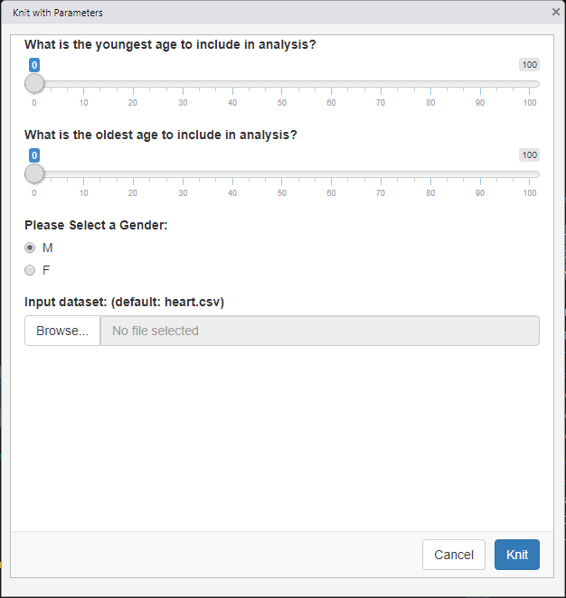
Parameters
params:
MinAge:
label: "What is the youngest age to include in analysis?"
value: 0
input: slider
min: 0
max: 100
step: 1
sep: ""
MaxAge:
label: "What is the oldest age to include in analysis?"
value: 0
input: slider
min: 0
max: 100
step: 1
sep: ""
Gender:
label: "Please Select a Gender:"
value: "M"
input: radio
choices: ["M", "F"]

Slide 22



Parameters
When to use Parameters:
Same report, different recipients
Same report, different date scopes
Varying plot needs
Periodic datasets changes
Note: Parameters can’t be run in standalone code chunks
Develop Accordingly!

Slide 23


Thank you!

